Slide 1

Dss(Digital Streaming System) Ultimate Digital labs
MATLAB BABAEV

Slide 2
DSS- Overview
API-GateWay
CloudConfig Microservice
Reviews Microservice
Movies Microservice
Actors Microservice
C R U D operations
C R U D operations
C R UD operations
Kafka – message queue

Slide 3






Development tools

Slide 4
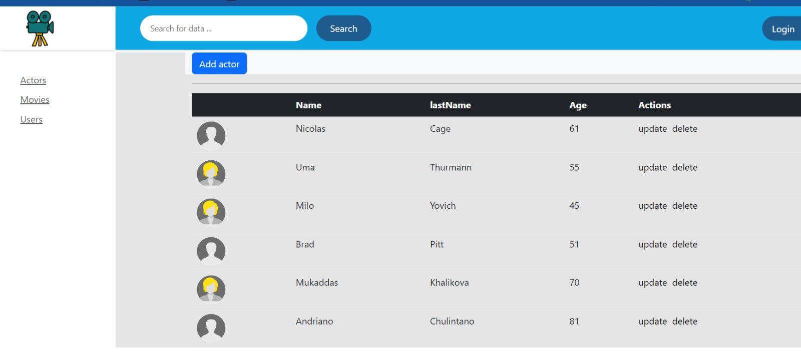
Actors list

Slide 5
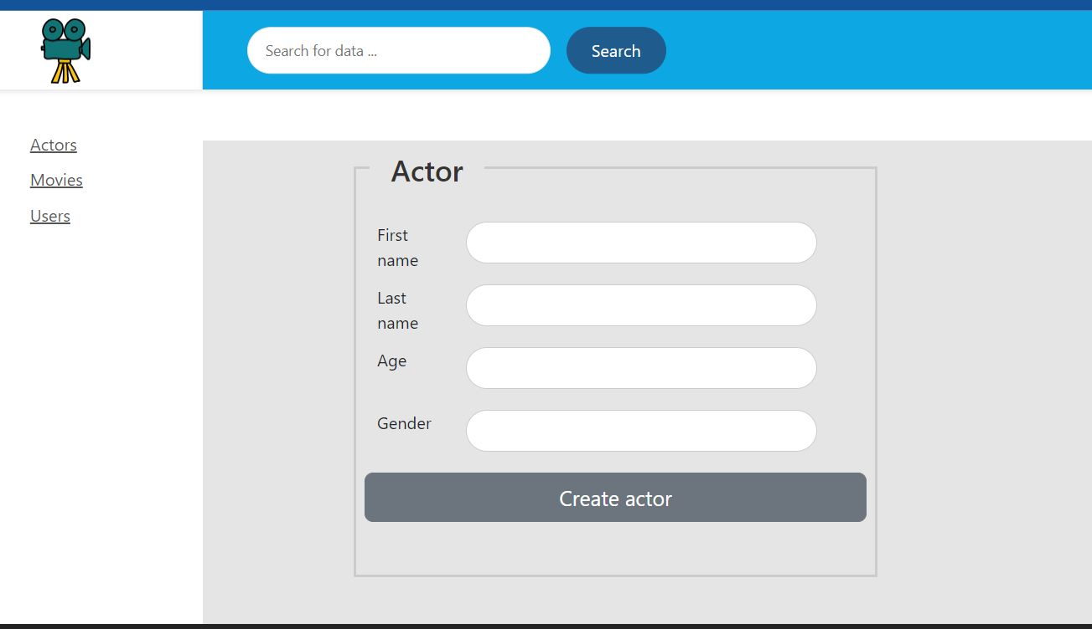
Actors adding

Slide 6
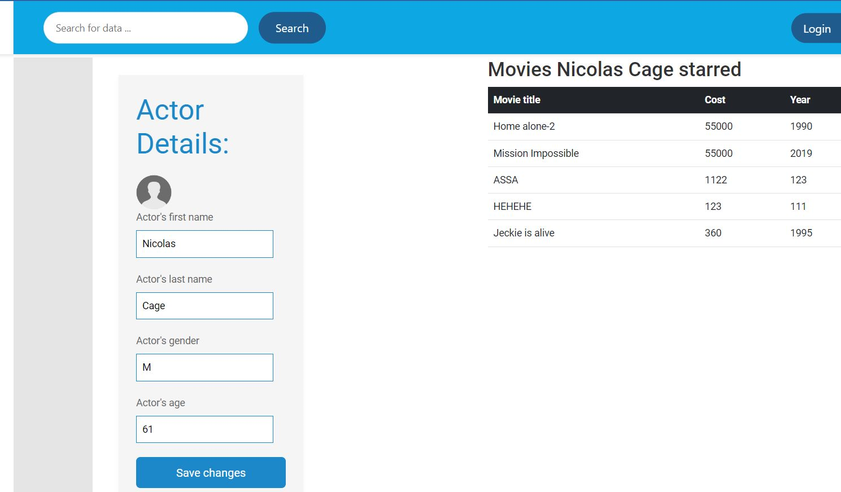
Actors updating

Slide 7
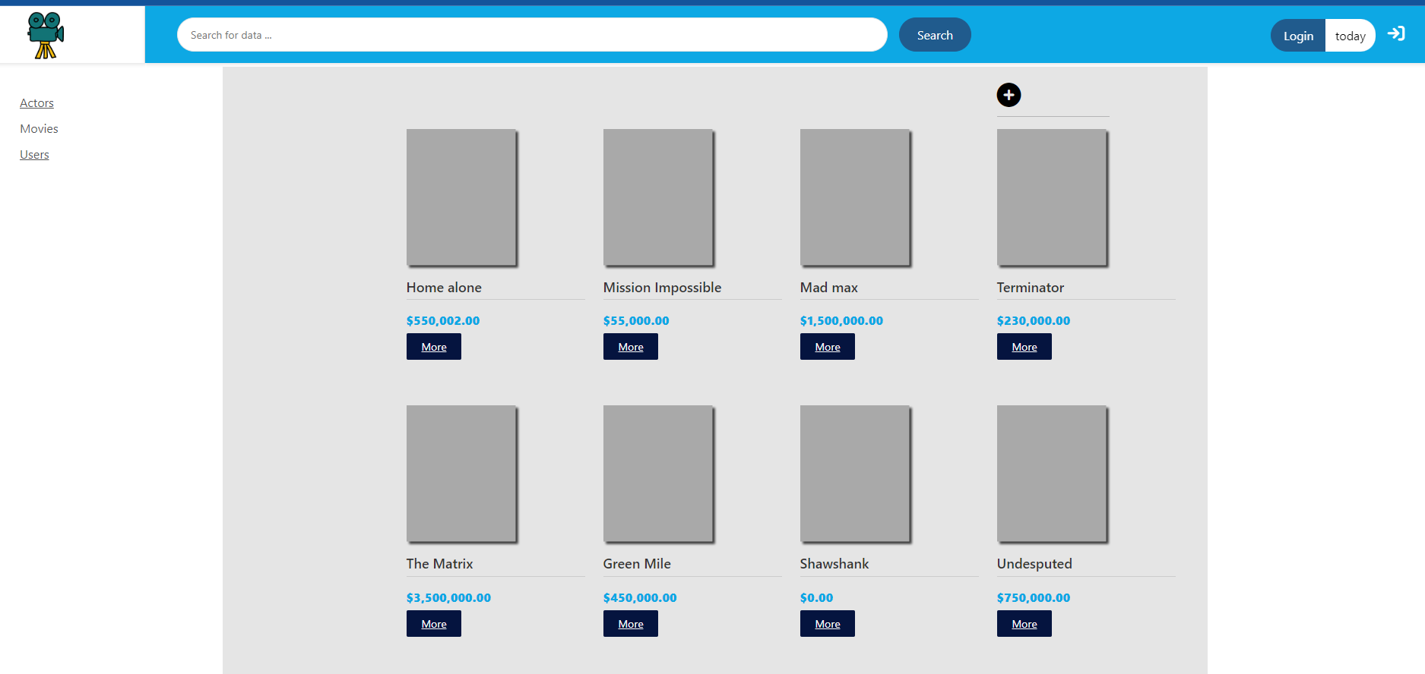
Movies list

Slide 8
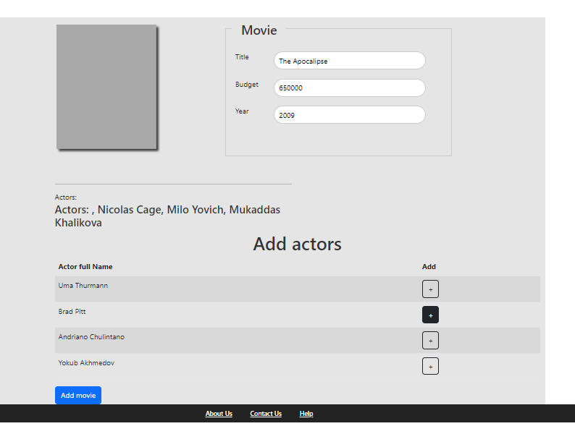
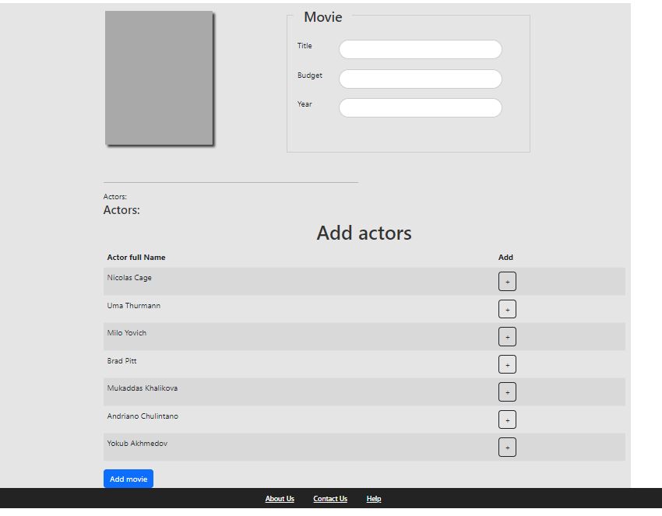
Adding movie

Slide 9
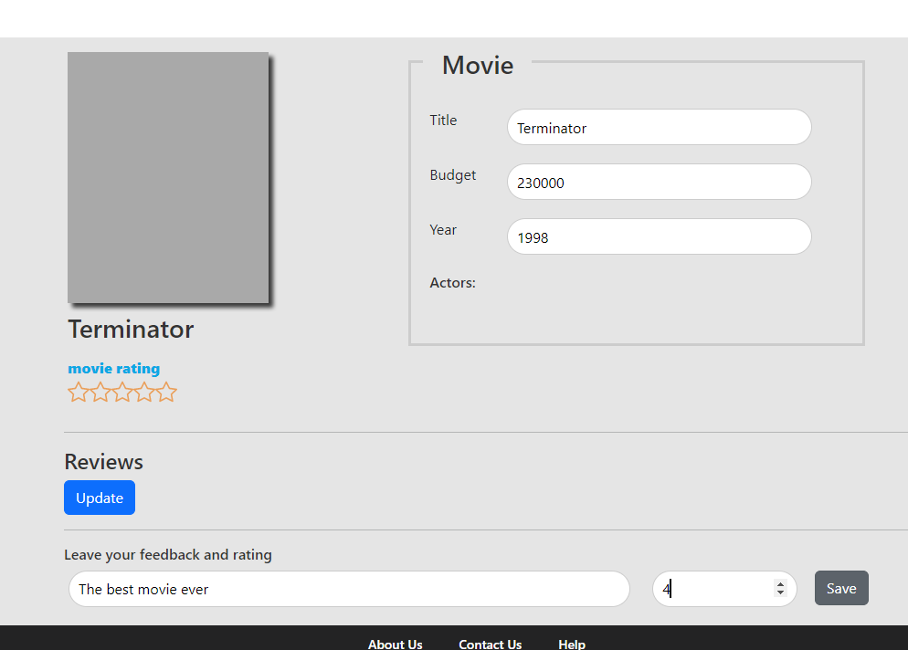
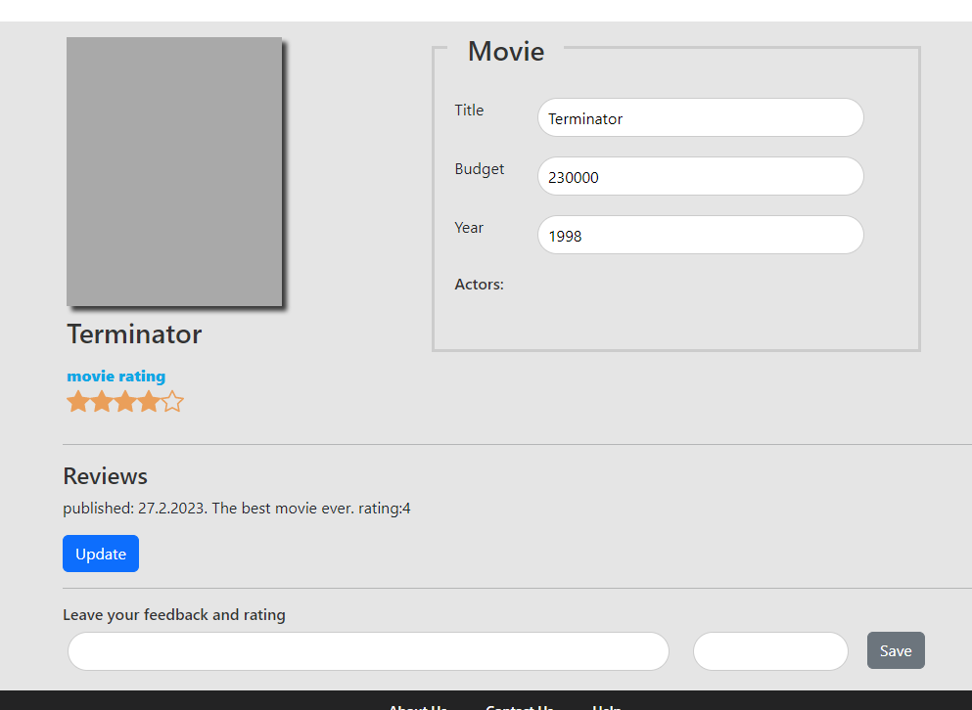
Editing movie

Slide 10
Editing movie

Slide 11
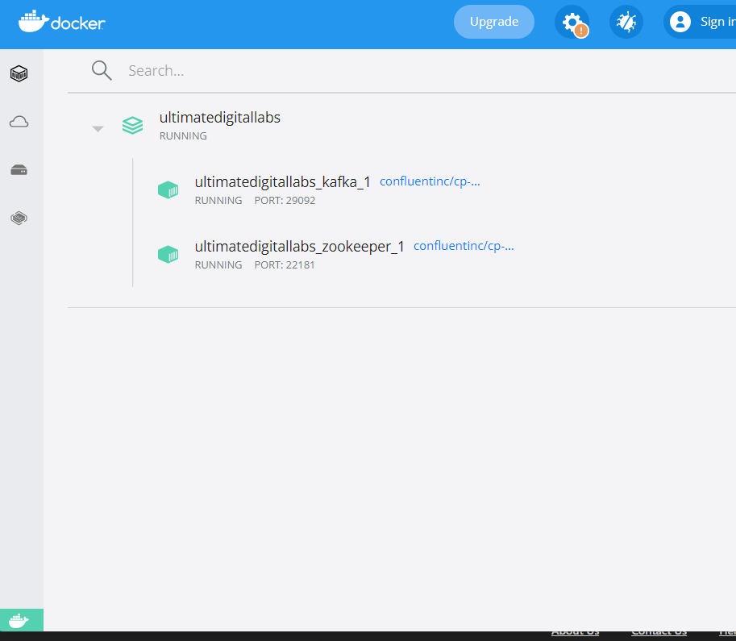
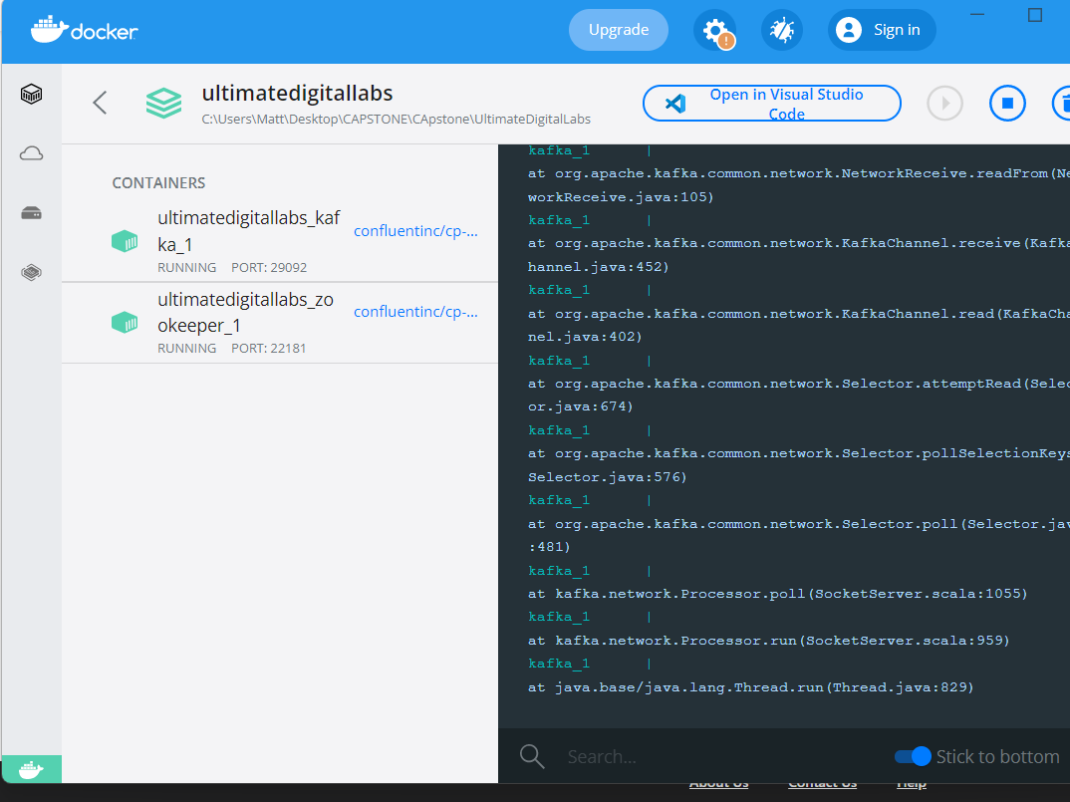
KAFKA running in docker container

Slide 12
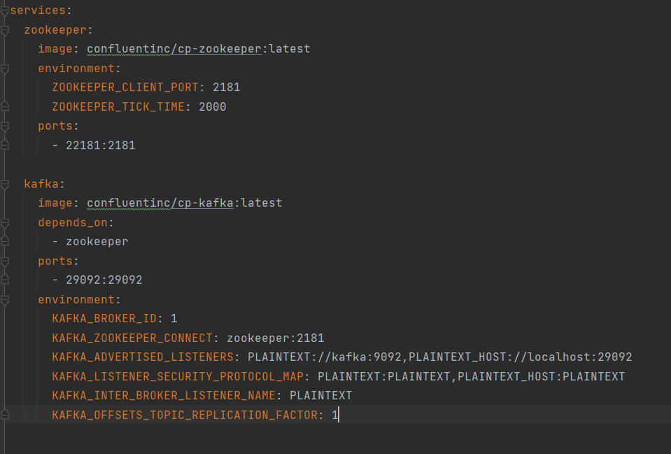
Kafka and Zookeeper from docker-compose

Slide 13
Kafka and Zookeeper from docker-compose

Slide 14
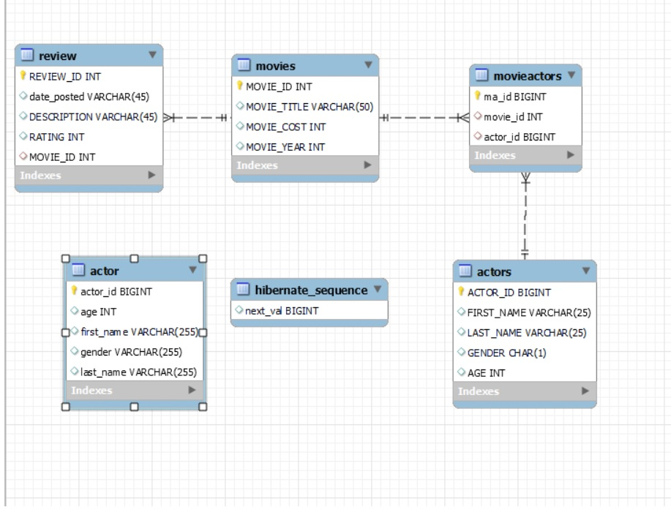
Table design

